Slide 1






Project Title
OLYM+
Students Name:
Atharv Khisti atharv.khisti@mitaoe.ac.in
Aditya Jadhav aditya.jadhav@mitaoe.ac.in
Muskan Dosi muskan.dosi@mitaoe.ac.in
Hridill Banik hridill.banik@mitaoe.ac.in
Guide:
Mr. Hrishikesh Mahure
Disclaimer: The content is curated for educational purposes only.
Notes:
Slides: Prepare a short slide deck (10-12 slides) summarizing the project objectives, methodology, and key results.
1

Slide 2
Project Title
OUTLINE
Abstract of the Project
Problem Statement
Proposed Solution
System Architecture
Live Demo of the Project
Embedded Video of Project
Conclusion
Future Scope
Notes:
2

Slide 3


Project Title
Abstract
Meal Prep.
Concept: Olym+ is a fast e-commerce platform aimed at fitness enthusiasts, providing meal boxes tailored to their body stats and fitness goals.Combines ready-to-eat and request-based freshly prepared meals.
Vision: To promote fitness and healthy living in India, addressing the rising obesity and diabetes rates.

Slide 4
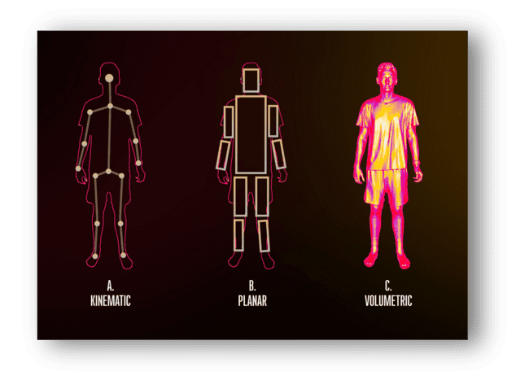
Project Title
Problem Statement
Olym+ aims to address this gap by offering a fast, full-stack e-commerce platform where users can create profiles, select or customize meal plans, and order ready-to-eat or freshly prepared meals, fostering fitness awareness and healthier lifestyles in India.

Slide 5

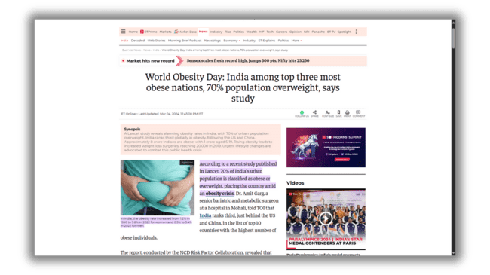
Project Title
Proposed Solution
A marketplace for ordering ready-to-eat meals and freshly prepared request-based meals.
Seamless navigation with a responsive app interface.
Personalized guidance via AI chatbot and optional human trainer support.
AI for meal personalization.
Mobile and web platforms for delivery services.

Slide 6
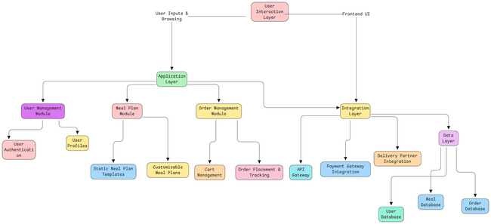
Project Title
System Architecture

Slide 7
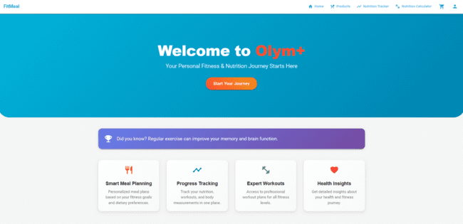
Project Title
Live Demo of Project
Live Demo Link
Live Demo WT - Google Drive

Slide 8
Project Title
Conclusion
The Olym+ project demonstrates the potential of merging e-commerce with AI-driven personalization to address modern lifestyle challenges such as obesity and poor dietary habits. By providing tailored meal solutions and a seamless user experience, the platform caters to the growing demand for convenient and healthy eating options.
Through the successful implementation of advanced technologies like secure payment gateways, dynamic product catalogs, and AI-powered recommendations, Olym+ has laid the groundwork for a scalable and impactful solution. The project not only highlights the importance of leveraging technology to enhance user engagement but also paves the way for future innovations in personalized nutrition and fitness-oriented e-commerce platforms. With continuous development and integration of new features, Olym+ has the potential to become a leader in the health-focused e-commerce domain.

Slide 9
Project Title
Future Scope
Develop a dedicated mobile application for enhanced accessibility and user engagement.
Integrate with fitness wearables like Fitbit and Apple Watch for real-time meal recommendations.
Employ advanced AI and machine learning to refine meal personalization and implement predictive analytics.
Scale the platform to support multiple regions with localization and expanded infrastructure.
Introduce subscription-based services for regular meal deliveries.
Add features for diet tracking, calorie counting, and live consultations with nutritionists.
Focus on sustainability with eco-friendly packaging and partnerships with local farmers.

Slide 10
Project Title
References:
Google LLC. MediaPipe: Cross-platform Framework for Building Perception Pipelines. Available at: https://mediapipe.dev
· J. -H. Lee, K. Kim, J. -H. Kim. A GAN-based Framework for Data Augmentation in Image Generation Tasks. Published in: 2021 IEEE VTS 17th Asia Pacific Wireless Communications Symposium (APWCS), September 2021.
· Kim, J.-W., Choi, J.-Y., Ha, E.-J., & Choi, J.-H.. Human Pose Estimation Using MediaPipe Pose and Optimization Method Based on a Humanoid Model. Published in: Applied Sciences, 13(4), February 2023. DOI: 10.3390/app13042700
· Antonelli, M., & Donelli, D.. Precision Nutrition and Artificial Intelligence Mobile Apps: A Narrative Review. Published in: Applied Sciences, February 2023. DOI: 10.3390/app13102700
· Stefanidis, K., Tsatsou, D., Konstantinidis, D., et al.. PROTEIN AI Advisor: A Knowledge-Based Recommendation Framework Using Expert-Validated Meals for Healthy Diets. Published in: Nutrients, 14(4435), December 2022. DOI: 10.3390/nu144435
· Smith, A., & Johnson, B.. AI-Driven Solutions in Fitness Tracking and Nutrition Planning. Published in: International Journal of AI Applications, March 2022.

Slide 11
Project Title
Thank you!
Notes:
thank you very much for joining this PPT, keep learning.
11

